Slide 1

Strategic Decision-Making Review
Final Update
April 2025

Slide 2


Agenda
Executive Summary
Macro Situation of the target industry
Assessing Value Chain Impact of Exiting In-House Production (Issue 1-3)
Strategic Shifts from Brick & Mortar to E-commerce (Issue 4)
Final Recommendations
Notes:
Recap
Ideal to prolong closure
Find ways to generate revenue

Slide 3



We divided the main problem into different goal statements focusing on each type of products
1. Should we close underutilized factory to cut costs?
Factory is underutilized
Higher raw material costs
Competition faced from low – cost Southeast Asia suppliers
Particularly impacted on smaller goods
2. How will exiting target goods affect sales in starter bundles and durable goods?
Exiting one business could impact starter bundles and durable goods viability
May reduce demand for standalone durable goods
Could weaken new customer acquisition via bundled items
3. Will exiting target goods hurt high-margin fast-moving goods’ sales?
Exiting target goods and durable goods may reduce long-term sales
Could weaken customer loyalty
Likely to impact profitability of high-margin items
4. How should marketing adapt to the shift from B&M to E-Commerce?
Need strategies to address shift toward private labels and other categories
Must adapt to growing share of E – commerce platforms
Focus on restoring volume, attracting new users, and retaining current consumers
Source: Kearney
Source: Kearney

Slide 4




Executive Summary
Factory Transition Plan
Optimize structural cost base by shifting production of target goods to Southeast Asia
Phased closure of the facility
Preserve large/commercial goods production if cost-effective
Retain B2B service capabilities
Fast-moving Goods Loyalty Loop
Protect high-margin fast-moving goods via sustained customer touchpoints
Preserve fast-moving goods as category anchors
Upsell via kits, bundles, and retail tie-ins
Monitor loyalty impacts post factory transition
Retail Strategy – Brick & Mortar
Secure shelf space and defend brand presence in-store
Bundle products with high-velocity categories
Negotiate premium shelf positions
Explore co-branded “value” vs “premium” strategy
E-Commerce Acceleration
Grow E-commerce share and drive digital-first discovery
Improve content score & SEO ranking
Target ads by age/demographic
Optimize RoAS using regression & LSTM models for ad timing and channel mix
Brand Strategy & New User Acquisition
Revitalize interest in target category through creative activation
Launch starter kits via social + influencers
Run seasonal or thematic campaigns
Align new kits with beginner-friendly fast-moving goods
Source: Kearney

Slide 5
We implemented a structured workplan to successfully complete the project for our client
Workplan as of Apr 24, 2025
Follow up
Expected
Activities | January |  |  | February |  |  |  | March |  |  |  | April
 | Week 1 | Week 2 | Week 3 | Week 4 | Week 5 | Week 6 | Week 7 | Week 8 | Week 9 | Week 10 | Week 11 | Week 12
Kick-off and Problem Identification |  |  |  |  |  | Midway |  | Final
Approach Framing & Initial Data Requests |  |  |  |  |  | Feedback |  | Exam
P1: General & Issue 1 Analysis |  |  |  |  |  |  |  | Week
P2: Issue 2 Analysis
P3: Issue 3 Analysis
P3.1: Follow up Issue 1 and Issue 2
P4: Issue 4 Analysis
P5: Recommendations and Reflection
MIDWAY FEEDBACK
FINAL EXAM
SPRING BREAK
Midway Presentations
Final Report Out

Slide 6








Market is slowing, retailers are shifting focus, and cheaper imports are rising—even as client’s sales hold steady, profit trends are beginning to shift
Market Landscape – Slow Growth & Rising Competition
Client Performance (2023 → 2024 Trends)
Slow Growth | Forecast CAGR of approximately 4–5% over the next several years, ranking among the slower-growing segments within the broader industry..
Consumer Shift | Ongoing consumer preference for more interactive or broadly appealing categories. New customer acquisition rates are moderating.
Retail Shift | Shelf space increasingly allocated toward higher-margin products. Private-label offerings gaining momentum.
Cost Pressures | Offshore suppliers undercut on price. Rising supply chain costs impact profitability.
E-Commerce Pressure | Large online marketplaces continue to grow, and challenge established brands Private labels and third-party sellers compete directly on price and convenience.
Target Goods | Sales stable but revenue slightly down. Profitability improved from –ve to +ve.
Durable Goods | Sales stable, maintaining market presence.
Fast-moving Goods | Sales inched up by one percent.
Profit | Durable Goods trending up. Fast-moving Goods facing pressure.
Further details of numeric data in Appendix 1
Source : Market Research

Slide 7
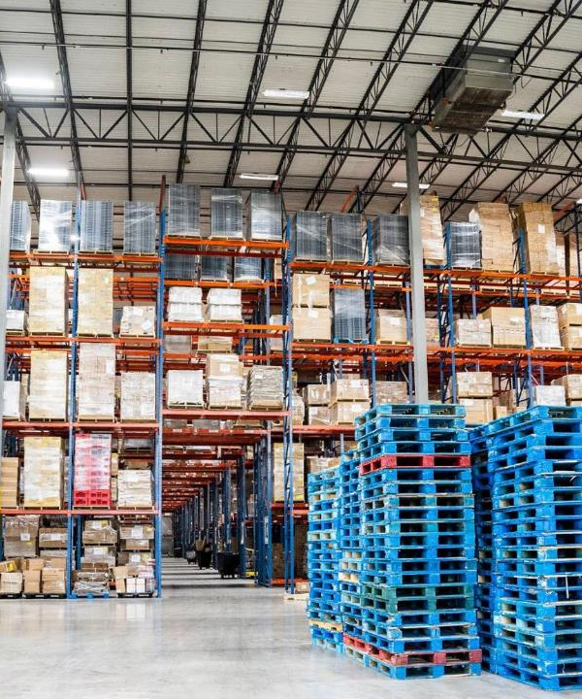
Assessing Value Chain Impact of Exiting In-House Production

Slide 8



Our client can gradually outsource production while shutting down the factory over time to reduce costs, ensuring long-term profitability
Status Quo
1. Mid-Term Evolution 12 Months
2. Long-Term Strategic Evolution
18-24 Months
Status Quo
Minimal financial disruption through smooth transition between in house and outsourcing
Outsourcing ≤ smaller goods
Cost assessment for remaining production
Gradual workforce and operational adjustments
Execution of fully outsourced model to stabilize and improve profitability.
Outsource all strategically viable SKUs through portfolio rationalization
Automation and process improvements
Mitigation of financial risks associated with factory closure
Our recommendation based on cost & business impact
 | Scenario A Baseline Status quo | Scenario B Partial outsourcing of smaller goods | Scenario C Full closure of manufacturing | Scenario D Phased closure of manufacturing
Key Changes | Maintaining existing manufacturing operations with stable but high - cost structures. | Minor reduction in cost when smaller goods are outsourced while keeping larger goods and commercial systems in-house. | Complete halt in production, eliminate manufacturing operations and cut fixed cost, but with a temporary financial impact and loss of existing revenue. | Phased closure with SKU-level outsourcing unlocks cost recovery while avoiding abrupt disruption—ensuring long-term profitability.
Total Annual Cost | $13.5M | $12.6M | $5.3M | $6.6M
Further details of numeric data in Appendix 2
Issue 1
Source: Kearney

Slide 9



Exiting the target goods has only a minimal impact on durable goods
In durable goods profit, only a small portion comes from customers who purchase goods.
Little impact on durable goods
Durable goods sales are independent of target goods, so exiting target goods will have minimal impact.
Profit Composition
Target Goods 3.74
Durable Goods 26
24.2%
From customer who buy durable goods alone
Reallocate resources
Shift investment from target goods to high-margin durable goods products.
Durable goods A: High Value
Durable goods B: Medium Value
Durable goods C: Low Value
Fast-moving Goods 70
1.8%
From customer who also buy target goods
Refer to Appendix 3.1 for durable goods' profit analysis by brand
Further details for competitive analysis by retailer by category Appendix 3.2
Beginner vs. Non-beginner complaints by category
Little impact on new consumer acquisition
Few beginner complaints from starter bundles suggest its minimal impact on new consumer acquisition if exited.
Durable Goods
2,203
10,560
12,763
Target Goods
2,187
2,750
Starter Bundles
1,255
1,665
Focus on prioritizing durable goods complaints
Durable goods have the most complaints, so prioritize fixing
them drives the biggest customer satisfaction gain.
Fast-moving Goods
52
746
Issue 2
Beginner Complaint
Non-Beginner Complaint
Source: Market Research

Slide 10
Exiting durable goods risks more than profit—it threatens retailer loyalty and fast-moving goods performance
Issue 3
Further details of numeric data in Appendix 4.1
1. Strong correlation between sales of durable goods & fast-moving goods
2. Retailer Purchasing Behavior
3. Durable goods & Fast-moving Goods by Brands
Category Correlation
Correlation between sales of durable goods and sales of fast-moving goods: Very High Correlation
If Client exits durable goods it may risk losing fast-moving goods sales as well
Retailers shift towards brands that still offer both durable goods and fast-moving goods
Double down on Brand A because it can help to maintain retailer loyalty and protect sales.
Durable Goods Sales Composition
1%
Correlation at Retail Level
Strong correlation suggests retailers prefer to stock both categories together.
Brand A
Brand D
Brand B
Brand E
Brand C
Actual Retail Units Growth Rate from 2023 to 2024
 | RetailerA | RetailerB | RetailerD | Retailer E
Fast-moving Goods | 5% | -14.2% | -28.2% | -11.5%
Durable Goods | 22.1% | -35.3% | -24.6% | -9.7%
Fast-moving Goods Sales Composition
1%
Brand A
Brand D
1%
10
Brand B
Brand G
Brand E

Slide 11
Strategic Shifts for Brick-and-Mortar & E-commerce

Slide 12
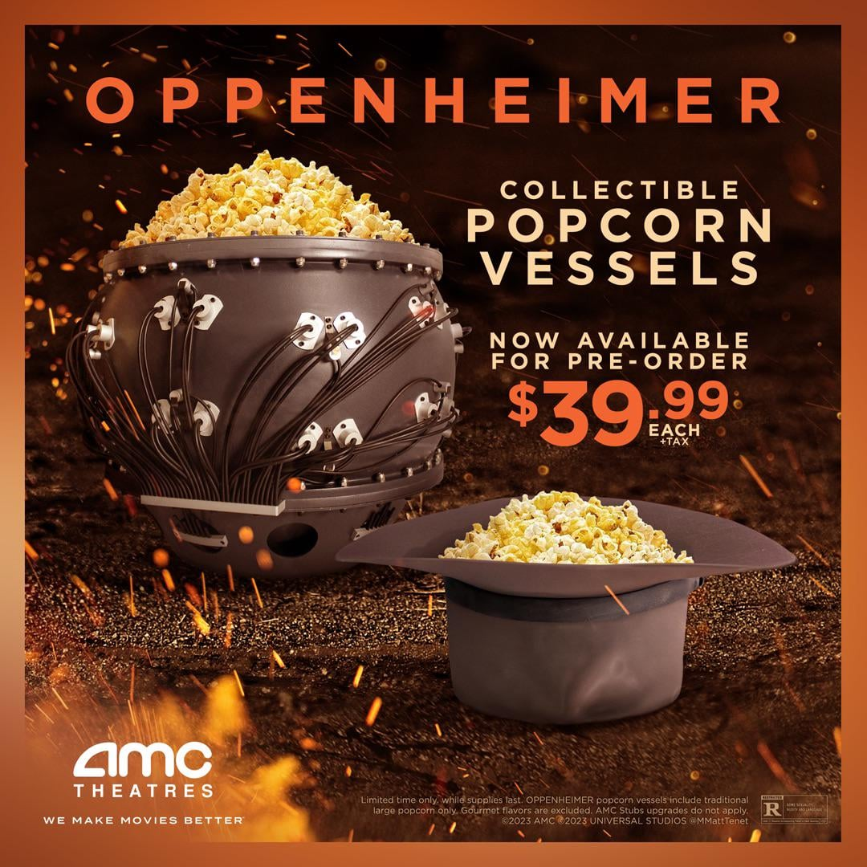




Strategies for Brick-and-Mortar: Boost sales by standing out through various retail execution levers
Bundling Promotions
Retailer specific bundles
Cross-channel promotion Tie-Ins
1
Private - Label Alternative Positioning
Negotiate Premium Shelf Space
3
2
“Premium vs. Basic” Messaging
Value-Added Packaging
Tailored Retailer Support
Eye – level placements
Performance based deals
Stretch level
> 6 ft
Eye level
4 – 5 ft
Touch level
3 – 4 ft
Stoop level
< 3 ft
Source : Market Research

Slide 13





Strategies for e-commerce: Increase competitiveness on Amazon by placement & advertisement
1. Improve organic and sponsored placement
2. Optimize return on advertisement spend
1.1. Improve product visibility with content score
2.1. Determine which categories to advertise
Analyze correlation between product content and content score
Improve content score to get higher placement
Use regression model to find the top categories generate the highest profit
Allocate budget based on forecast results
1.2. Choose better advertisement type
Calculate RoAS to decide which Amazon PPC ads we should invest in
2.2. Determine when to advertise
Analyze various benefit indicators to determine the promotion time based on monthly, weekly, holiday trend
Train LSTM model to predict best promotion time and spend
1.3. Target platform to attract more customers
Targeting Client’s key age demographics with social media advertising
Choose high audience reaching platform
Focus on social platform with better ROI
Source: Kearney

Slide 14





Strategies for e-commerce: Enhancing product appeal by better pricing & rating
1. Key questions to consider
What factors influence consumers decides to purchase when they visit the product page?
If consumers compare our product to that of a competitor, which one will they choose?
1
2
2. Potential next steps
Pricing Strategy
Rating Strategy
Further details explaining potential next steps Appendix 4.2
Compare
price index
Understanding
Customer
Feedback
Raise
the price
Reduce
the price
Enhancing
Product
Perception
Encouraging
Positive
Reviews
Source : Market Research

Slide 15

Final Recommendations

Slide 16



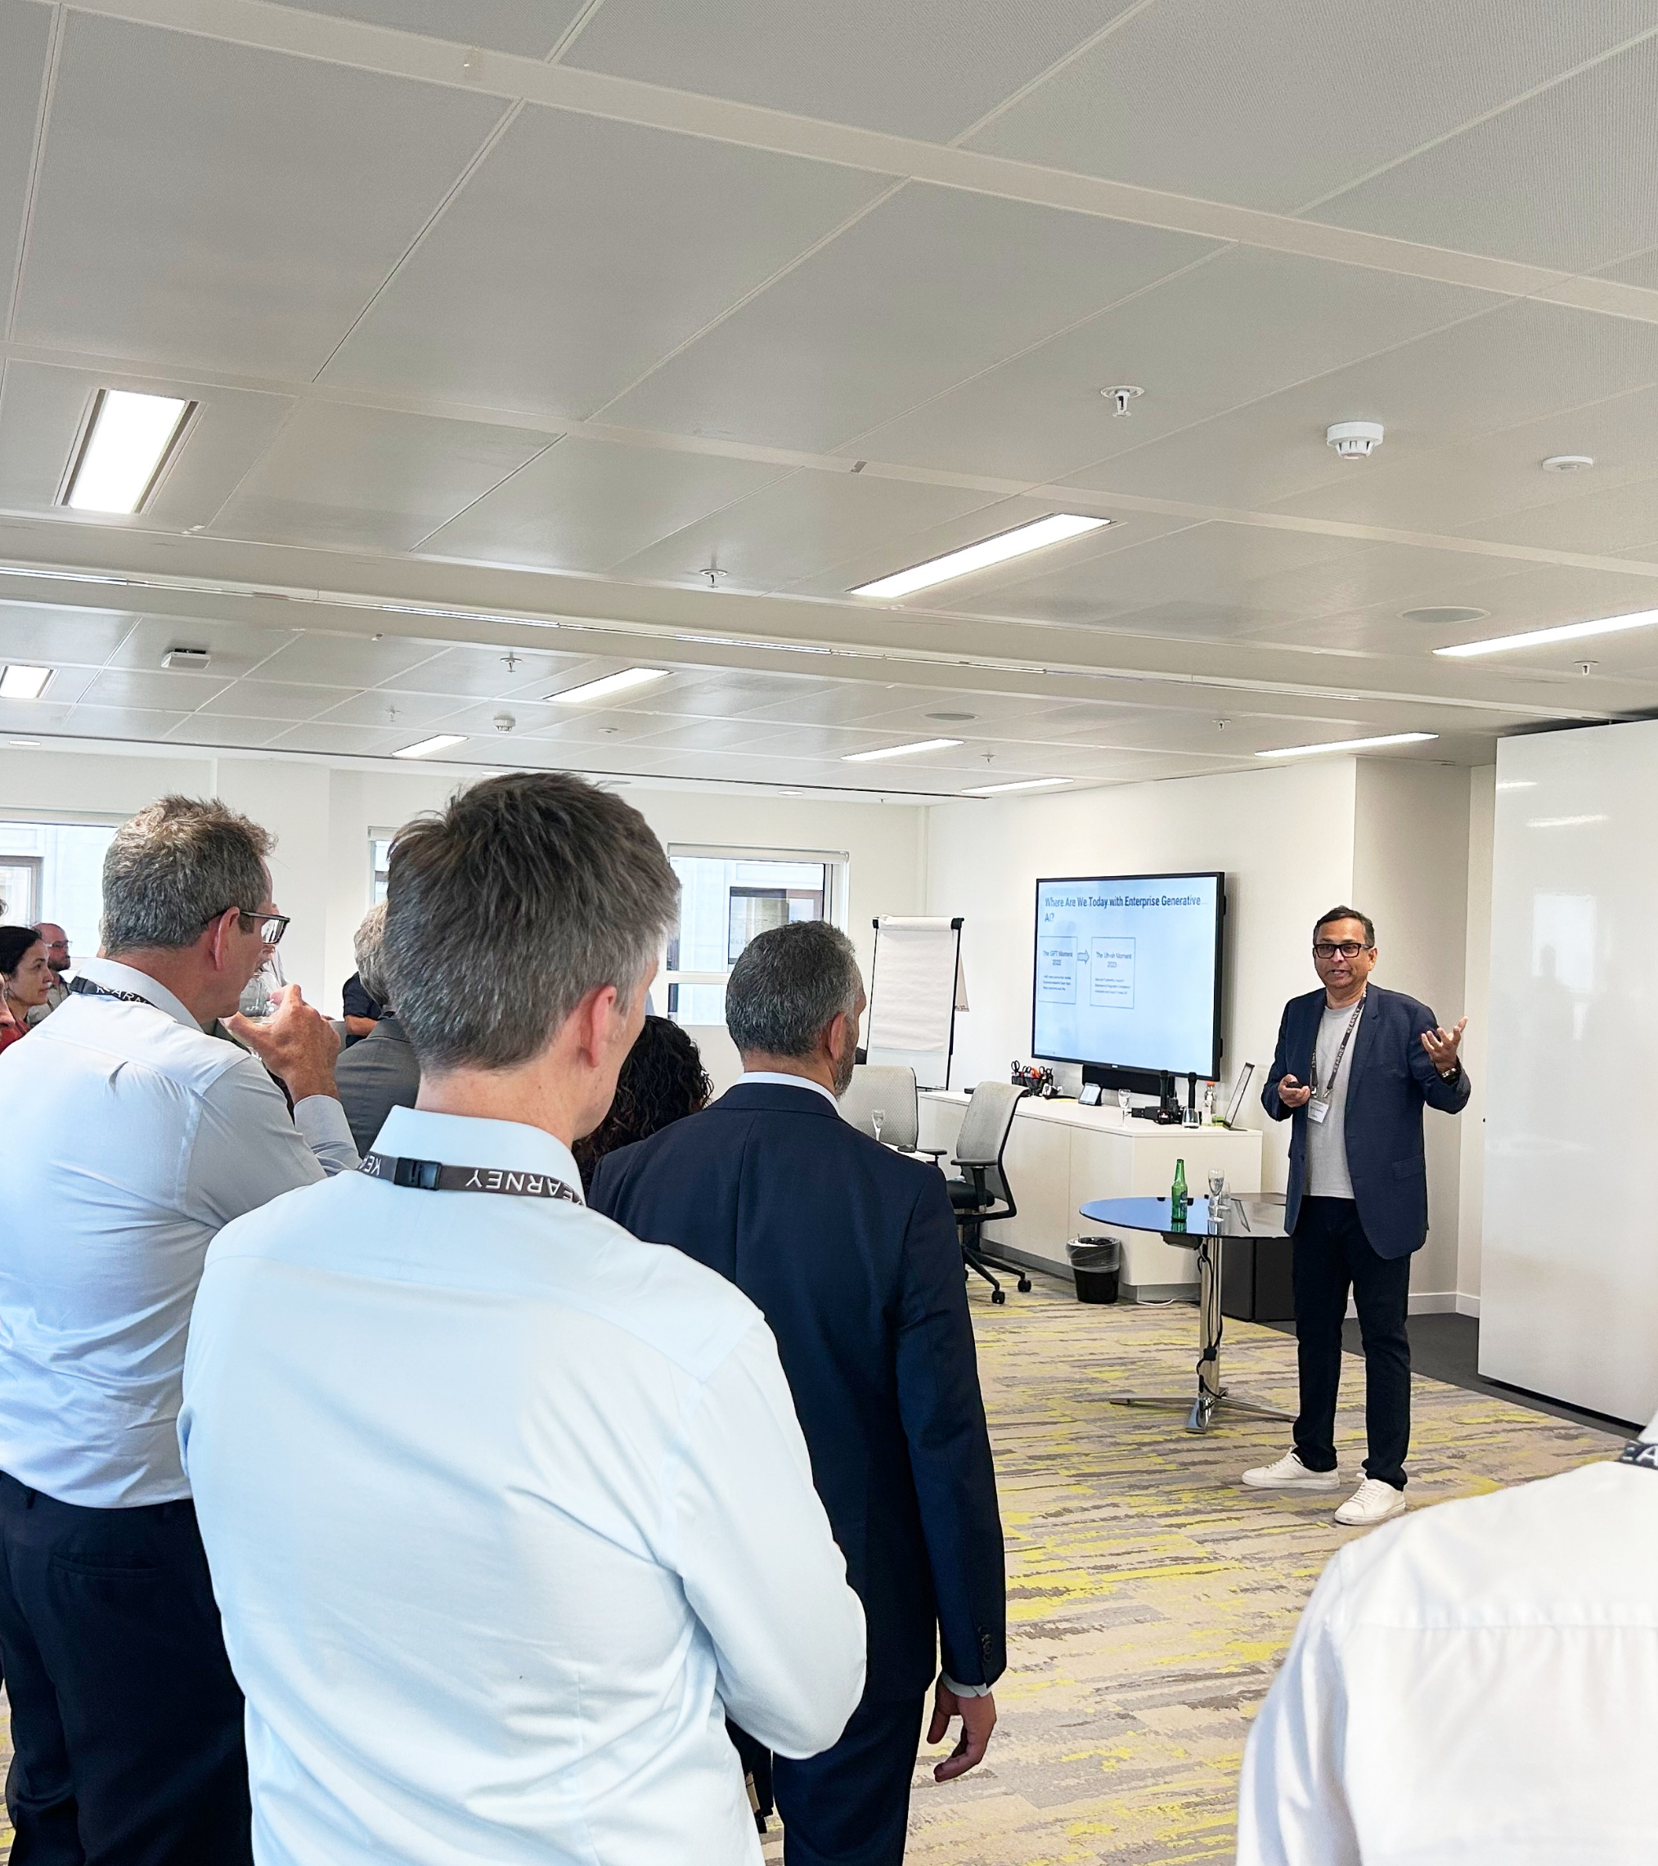

Strategic Path Forward
Phased Cost Recovery Post Factory Closure
Boost on Durable Goods sales
Preserving Durable goods to protect
Fast-moving Goods
Phase out plant operations to cut structural costs
Outsource smaller goods first, with a roadmap to full external production in 18–24 months
Maintain investment in high-margin, high-loyalty SKUs
Leverage kits and bundles to drive trial and repeat
Durable goods are essential for retaining Fast-moving goods sales and shelf presence—dropping them risks erosion across the portfolio.
Brick & mortar: Defending shelf space through retail execution levers
E - commerce: Dominating digital channels through optimized KPIs
Secure premium shelf placement, defend against private label with differentiated messaging, and accelerate sales through bundled SKUs.
Elevate Amazon performance with SEO-driven content, targeted ad spend, and review optimization to win both traffic and conversion.
Source: Kearney

Slide 17








Next steps for client is to implement our strategic recommendations
Potential next steps for the client
Start transformation efforts to implement manufacturing transition considering tariff environment
Perform quarterly customer sentiment analysis and compare with competitors
Improve marketing efforts through right placement and details
Enhance strategic partnerships with e-commerce and B&M retailers
Create change management plan for the teams with new strategy
Success considerations
Market Sensing
Tariff Environment
Product Differentiation

Slide 18
Appendix
Contents
Key market numeric data
Summarized competitive analysis data
Scenario based models
Projected outsourced growth
E-commerce strategy
Customer data analysis
Price index of various brands
Key risks

Slide 19

Appendix 1 Key Numeric Data (2023–24)
The overall market contracted by 8%, while Client’s share dropped from 17.3% to 16.3% (a relative decline of about 5.8%)
Target Goods sales remained steady at 8%, but the total revenue saw a slight drop.
Target Goods profitability turned
around—from a negative -1%
in 2023 to a positive 3.74% in 2024.
Back to main slide
Durable Goods' sales remained
steady at 25%, while Fast-moving Goods grew slightly from 66% to 67%.
Durable Goods' profit contribution increased from 23% to 26%, while Fast-moving Goods dropped from 78% to 70%.

Slide 20
Appendix 2.1
Potential Scenarios
Recommended Scenario
 |  | Scenario A Baseline Status quo | Scenario B Partial outsourcing of smaller goods | Scenario C Full closure of manufacturing | Scenario D Gradual Cost Recovery Post Closure
Cost | In House | $ 13,468,970.73 | $ 10,884,496.91 | $ 9,255,983.12 | $ 9,255,983.12
 | Outsourced | $ 0 | $ 1,744,924.41 | $ (4,000,000.00) | $ (2,604,221.28)
Customer Contribution | Commercial | $ 1,215,836.95 | $ 1,215,836.95 | $ 0 | $ 204,221.08
 | Non Commercial | $ 1,738,762.21 | $ 1,738,762.21 | $ 0 | $ 0
Sales Volume | Commercial | $ 91,288.00 | $ 91,288.00 | $ 0 | $ 160,804.00
 | Non Commercial | $ 209,459.00 | $ 209,459.00 | $ 0 | $ 0
Back to main slide
Assumption :
If the factory closes in March 2025, we assume it will incur sunk costs for the rest of the year. Based on this, at least half of the total annual cost can be considered sunk.

Slide 21
Appendix 2.2
Key Considerations
Outsourcing costs should be maintained for the initial year(s)
Labor that was laid off from previous year would be compensated for 6 more months
Back to main slide
Implications
Scalable & effective in long term
Risk is reduced
Calls for Change Management
More scalable in the long run (following years)
Assumptions :
We factor in outsourcing quotes to estimate potential sales volume for Year 1. Since it would be the first year to outsource, production might only go as high as 80%
Each month production increases by 10%
Gradually shifting into outsourcing may become profitable.
Total Cost ~ $ 1.7 M
Potential Customer Contribution ~ $ 204 K
Source: Internal Data

Slide 22
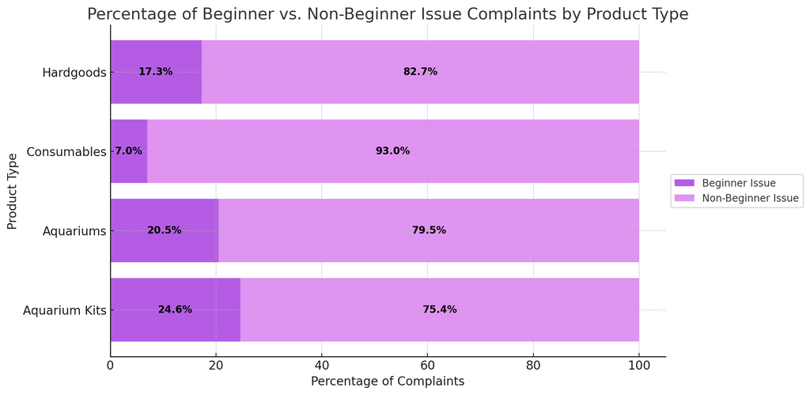


Appendix 3.1
Durable Goods Profit Analysis by Brand
Brand | Durable Goods Percentage | Durable Goods Profit from Target Goods
Brand D | 84.9% | 6.5%
Brand A | 26% | 0.9%
Brand B | 61.8% | 15.4%
Back to main slide
Beginners vs. Non-beginners Complaints by Category
Durable
Goods
2,203
10,560
Fast-
moving
Goods
52
694
Beginner Issues
Confusion about setup or usage
Missing or malfunctioning components
Frustration from unclear instructions
Target Goods
563
2,187
Starter bundles
410
1,255

Slide 23

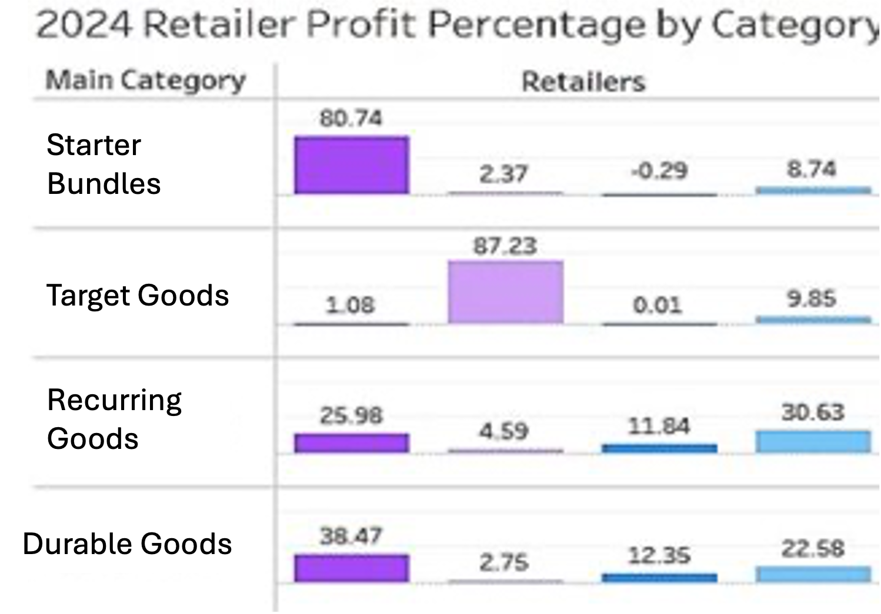


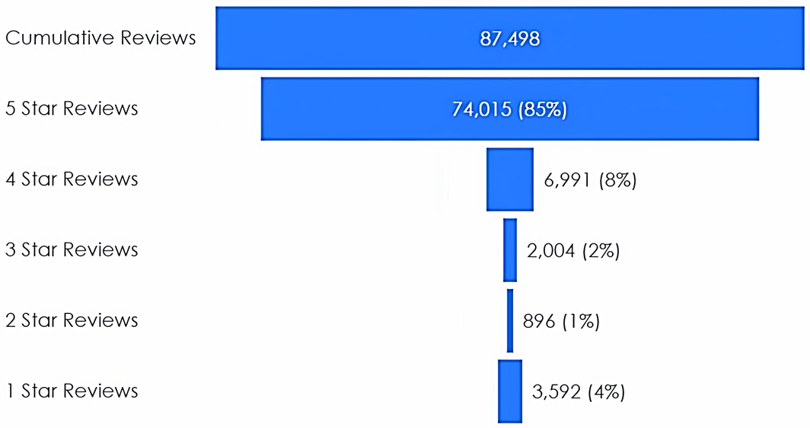
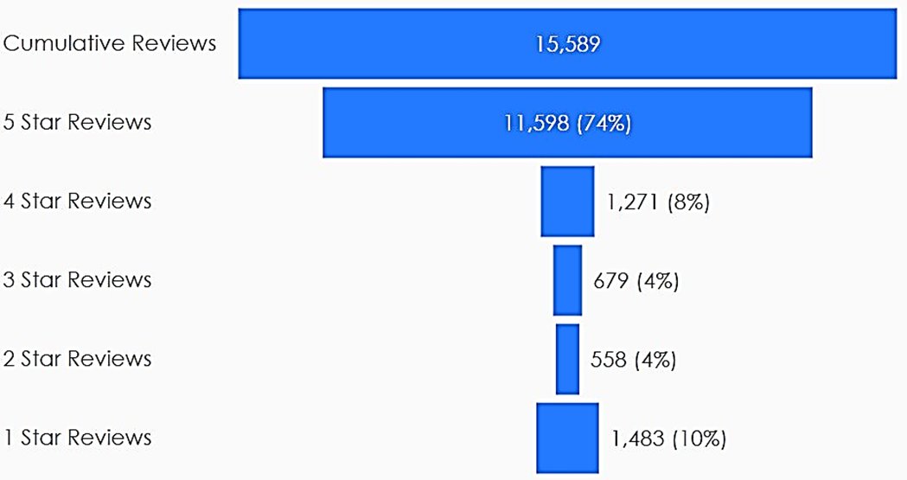
Good standing, ≤0.2 Differences, >0.2 Differences
Appendix 3.2
Competitive Analysis by retailer by category
Key Retailers Ratings by Category (Client vs. Competitors)
Category | Brand A | Brand B | Brand C | Brand D
Starter bundles | 4.1 vs. 3.9 | 3.4 vs. 4.4 | 3.7 vs. 3.9 | 3.6 vs. 4.0
Durable Goods | 4.4 vs. 4.3 | 4.3 vs. 4.1 | 3.8 vs. 4.2 | 4.3 vs. 4.2
Target Goods | 4.3 vs. 4.2 | 3.5 vs. 4.5 | 3.0 vs. 4.2 | 3.9 vs. 4.1
Fast-moving Goods | 4.6 vs. 4.5 | 4.5 vs. 4.7 | 4.3 vs. 4.5 | 4.6 vs. 4.6
Poor Performers
Brand B: Starter Bundles & Target Goods
Brand C: Durable Goods & Target Goods
Brand D: Starter Bundles​ & Target Goods
Data Source: Profitero
Top Retailer Contributors
Priorities
Starter Bundles: Retailer A
Target Goods: Retailer B
Fast-moving Goods: Retailer A, Retailer E
Durable Goods: Retailer E
Focus on both poor performers
& top retailer contributors​
Retailer E: Fast-moving goods
Retailer B: Target Goods
Back to main slide
Examine ratings of key retailers to identify gaps and areas for improvement compared to competitors.
Data Source: Sales by customer by SKU
Retailer E: Fast-moving Goods Ratings
Brand D : Target Goods Ratings
Retailer E fast-moving goods: 1 Star Reviews
20.5% Retailer E Products
19.5% Retailer E Products
​
Retailer B Target Goods: 1 Star Reviews
33.4% Brand D Product
Data Source: Profitero

Slide 24
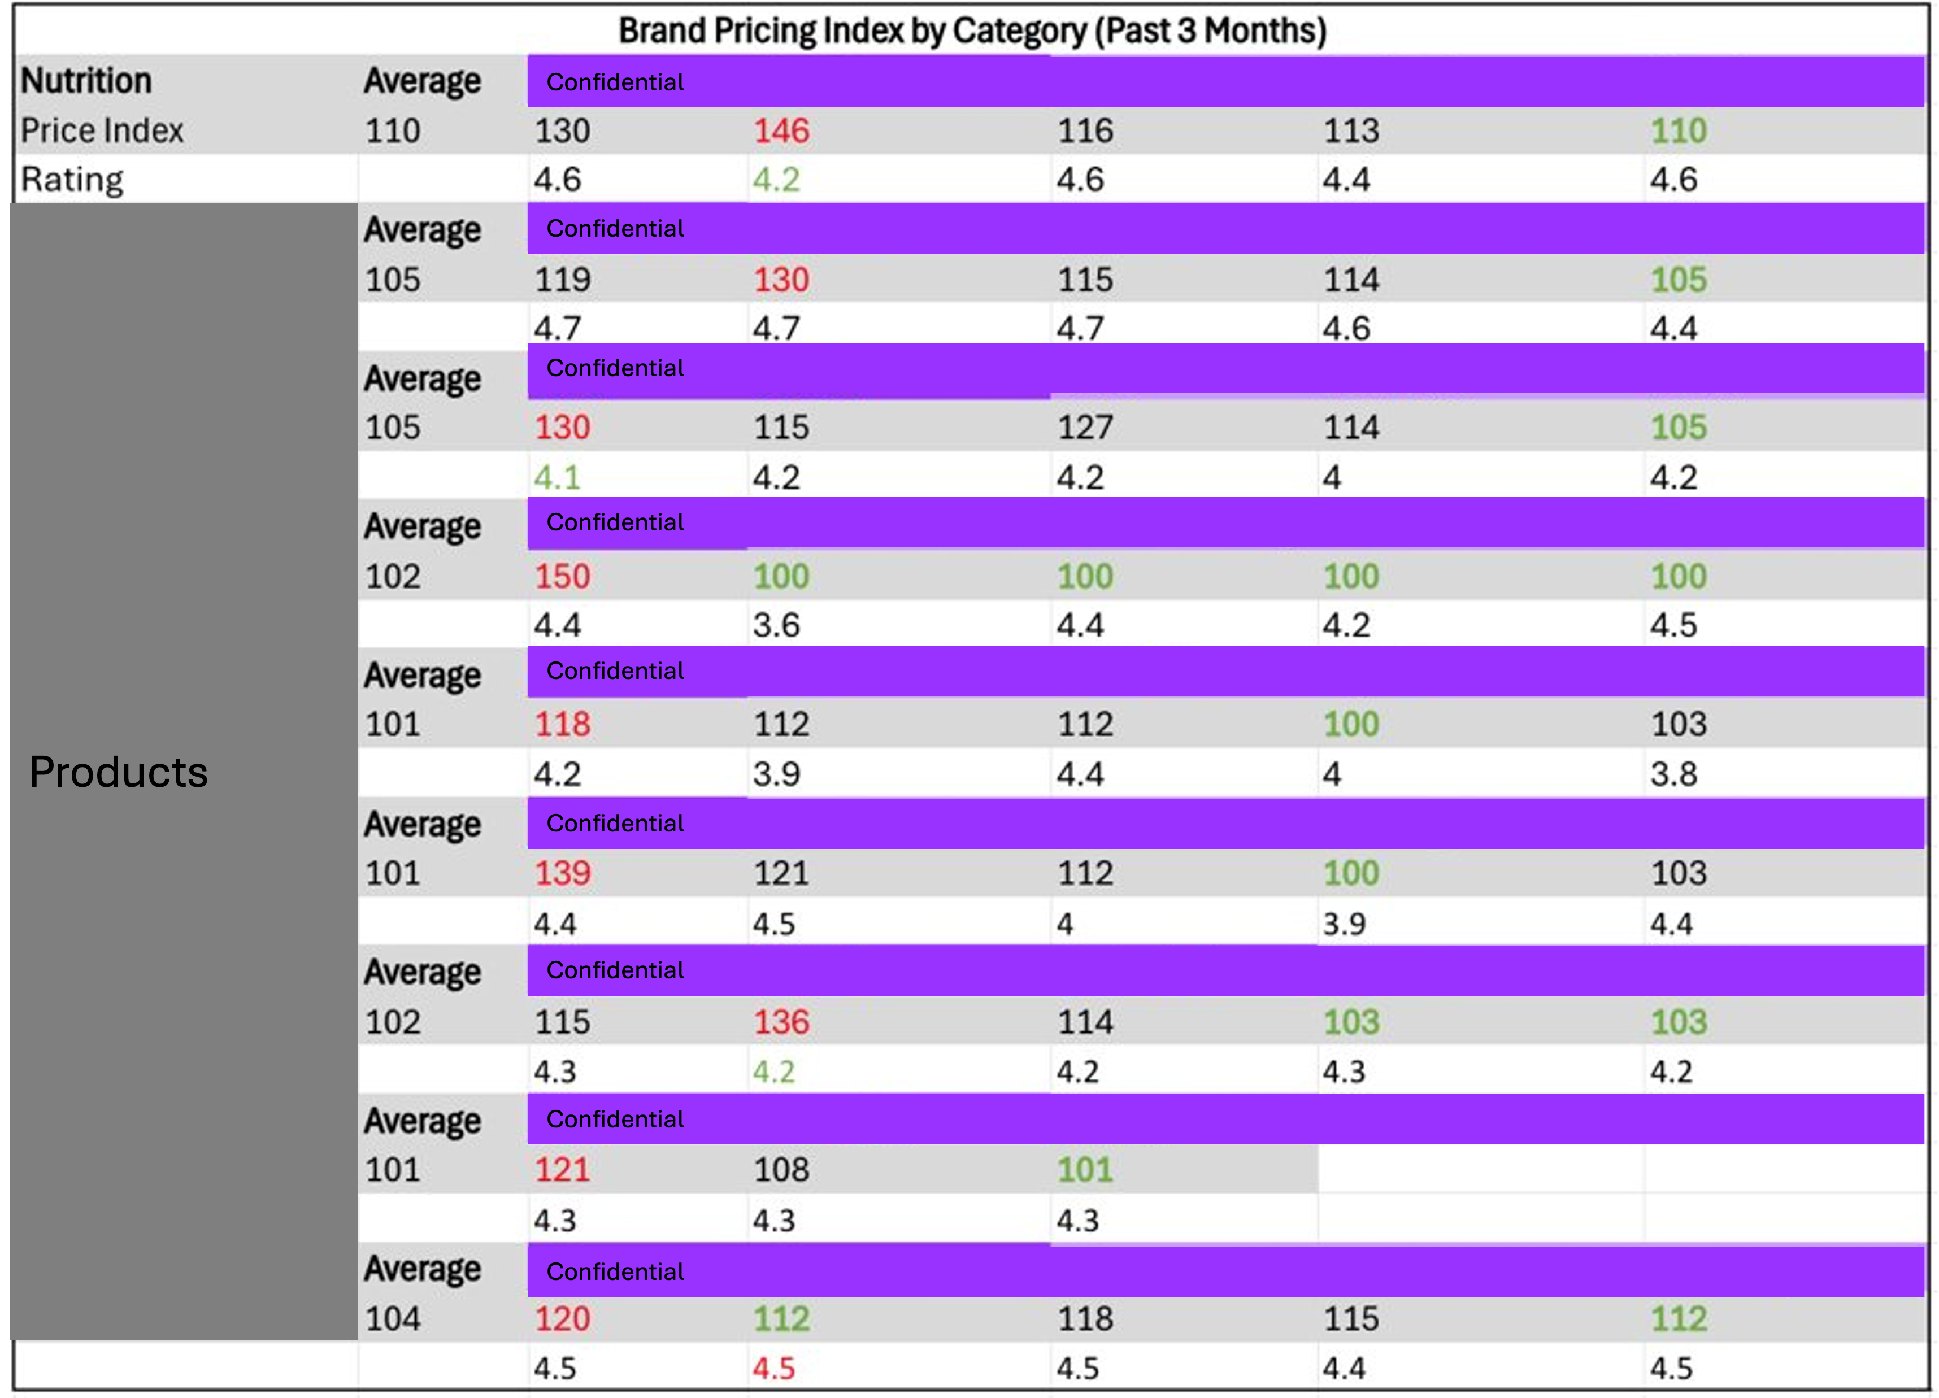
Appendix 4.1
Back to main slide

Slide 25
Appendix 4.2 Potential Next Steps
Pricing Strategy
Use good pricing to enhance customer retention then increase the company's competitiveness
Compare price index
Raise the price
Reduce the price
Compare Client’s price index with other competitors in different product categories
Increase the price of products with high reviews but low prices
Reconsider the price of products with the highest price index but poor ratings
Back to main slide
Understanding
Customer Feedback
Enhancing Product
Perception
Encouraging
Positive Reviews
​Identify lower rating categories, including different products
Hardware based issues are a leading complaint generator.
Use high-quality images and short videos showing the product in use inside actual target products
Highlight before-and-after setup shots or easy setup guides for new users
Rewards Review Program
Build Campaign Website
Share Experience
Get Rewarded
Rating Strategy
To increase product ratings on Amazon to drive sales without changing the pricing strategy

Slide 26
Appendix 5 Key risks to consider
Category | Risk | Mitigation Action
New Player Risk | Emerging competitors may disrupt market share or pricing | Conduct regular market scans; develop differentiated offerings; strengthen customer loyalty programs
Price Volatility | Fluctuations in input costs or market prices can impact margins | Implement long-term supplier contracts; use financial hedging; adjust pricing strategies dynamically
Geopolitical Risk | Political instability or regulatory changes in key regions | Diversify supply base; establish contingency plans; monitor geopolitical developments
US Tariff Changes | Increased costs due to changes in import/export tariffs | Explore alternate sourcing regions; re-negotiate supply agreements; adjust cost pass-through mechanisms
Supply Chain Disruptions | Delays or shortages in key inputs due to logistics or supplier issues | Develop multi-sourcing strategies; build buffer inventory; digitize supply chain monitoring
Technology Obsolescence | Rapid tech advancements may render current systems less competitive | Invest in R&D; establish innovation labs; adopt agile tech evaluation and upgrade processes
Non-Exhaustive

